Slide 1
IBM Watson Data Expert Services Learn Recap Watson Studio

Slide 2
We took a deep dive through Watson Studio and Watson Machine Learning
Watson Studio
Watson APIs
Connect & Access Data
Search & Find Relevant Data
Prepare Data (Ingest, Curate, & Enrich)
Build & Train AI Models
Deploy AI Models
Monitor, Analyze, Manage
Continuous Learning
Watson Machine Learning and Deep Learning as a Service

Slide 3
We explored a sample problem that helped us exercise the tooling
“What are our retention and churn rates across products and geos?”
“How can I get better targeting and success in customer retention?”
Visualize &
Explore Insights
Business Analyst
Fetch Data
VP of Marketing
Curate
“Can we refine our customer segmentation model and develop more refined propensity models?”
Data
Data Steward
Data Engineer
Provide Data or Visualization
Rapid data evaluation and extraction of necessary attributes to support analysis
Discovery through shop for data
Rapid hypothesis testing
Iterative analysis and model building through discovery and collaboration
Deploy scoring models into existing campaign management processes
Fetch Data
Conform
Data
“What data attributes are in the available sets of data which can be used ?”
Data Scientist
Visualize &
Explore Insights
Build Models
Notes:
This is an example of a business problem that is directly associated with churn analysis. It starts with a request from the business, the VP of Marketing, presents a business problem to the business analyst. The Marketing question is “How can I get better targeting and success in customer retention?”. In the case of a mobile telephone service provider, churn is defined as how frequently a customer discontinues their service to move to a competitor. This is frequently referred to as a retention issue, how do you retain the customer.
The business analyst starts to look at the question and wants to understand what the current churn rates are. To do this the business analyst can go out to the data catalog and “fetch” an existing file that the data steward has already curated. This file might contain customer churn data. The business analyst can explore the data and maybe build a report from it. In addition, the analyst might want to do some analytics on the dataset to understand what the key elements are that affect churn. However, for a much deeper understanding which a detailed model would provide, the business analyst would reach out to a data scientist who can analyze broader sets of data and attributes.

Slide 4




We developed an understanding of how the Watson Data tools enable team productivity and collaboration
Tanya
Domain Expert
Mike
Data Scientist
Ed
Data Engineer
Deb
The Developer
Her Job:
To transfer knowledge to Watson for a successful user experience.
His Job:
Transform data into knowledge for solving business problems.
His Job:
Architects how data is organized and ensures operability
Her Job:
Builds AI application that meet the requirements of the business.
What she does:
Range of domain knowledge and uses that to teach Watson and develop a custom models
As Tanya gains more experience she optimizes her knowledge to teach Watson to design better end-user experiences.
What he does:
Runs experiments to build custom models that solve business problems.
Use techniques such as Machine Learning or Deep Learning and works with Tanya to validate success of trained models.
What he does:
Builds data infrastructure and ETL pipelines. Works with Spark, Hadoop, and HDFS.
Works with data scientist to transform research models into production quality systems.
What she does:
Starts PoCs which includes gathering content, dialog building and model training
Focus is on app building for the team or company to use. Will handle ML Ops as needed
Sometimes known as:
Subject matter expert, content strategist.
Sometimes known as:
ML/DL engineer, Modeler, Data Miner
Sometimes known as:
Data infrastructure engineer
Sometimes known as:
Front-end, back-end, full stack, mobile or low-code developer

Slide 5
Additional Resources
Here are a few resources you might find helpful as you go forward:
Medium.com URLs - https://medium.com/ibm-watson
IBM DeveloperWorks - https://developer.ibm.com/components/watson-studio/
Cognitive Classes AI - https://cognitiveclass.ai/
GitHub sample collateral - https://github.com/ibm-watson-data-lab
Stack overflow - https://stackoverflow.com/search?q=Watson+Studio
Updates to Watson Studio - https://www.ibm.com/sg-en/cloud/watson-studio

Slide 6
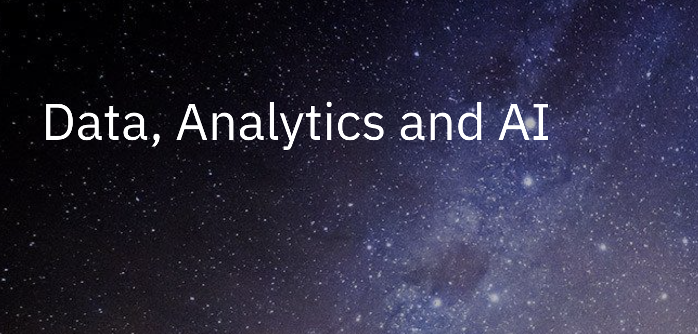

Identify and prioritize your use cases based upon your expected return Prepare a plan to realize your highest priority use case Build a prototype Expand the prototype into a pilot and deploy it
What are your next steps?
Notes:
Thank you _ help you on your journey – we’re here to help you

Slide 7
Questions

Slide 8
Thank you!

